Slide 1
Microbes in the Food Industry

Slide 2
Fermented Foods
Fermented foods are the foods which are produced or preserved by the action of microorganisms.
Food fermentation as a form of energy-yielding microbial metabolism in which an organic substrate usually a carbohydrate is incompletely oxidized and an organic carbohydrate acts as an electron acceptor.
Originally, food fermentations were carried with the primary purpose to achieve preservation effect for long-term use

Slide 3
Milk constituents
https://www.ilri.org/InfoServ/Webpub/fulldocs/ilca_manual4/Milkchemistry.htm

Slide 4
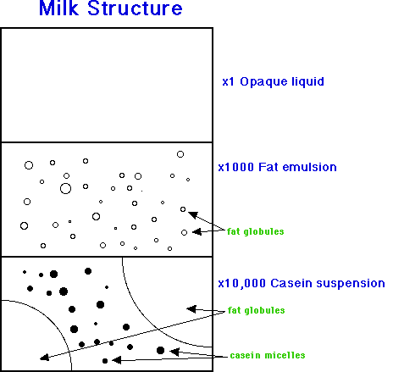
Milk
https://www.uoguelph.ca/foodscience/book-page/milk-structure

Slide 5
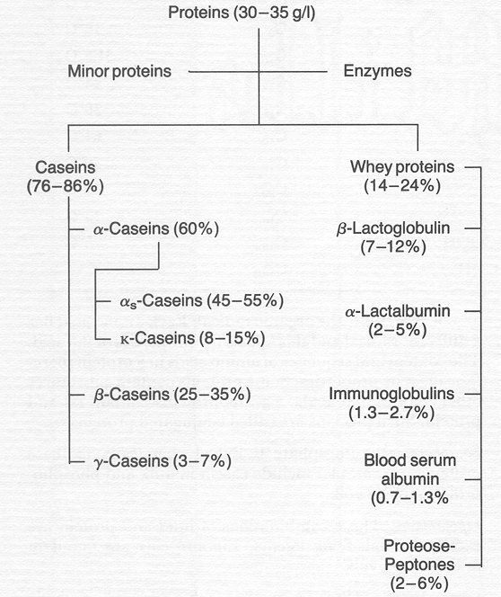
Milk Proteins
https://www.ilri.org/InfoServ/Webpub/fulldocs/ilca_manual4/Milkchemistry.htm

Slide 6
Casein micelles
Paul S. Kindstedt, University of Vermont

Slide 7
Dairy products
Yoghurt
Yoghurts are traditional sour milk preparations that have become major dairy products.
Inoculation involves a mixed starter culture containing thermophilic strains of Streptococcus thermophilus and Lactobacillus delbrueckii ssp. bulgaricus in a ratio of 1 : 1.
Streptococcus thermophilus produces mainly acid,
Lactobacillus delbrueckii ssp. bulgaricus generates more organoleptic compounds, particularly acetaldehyde.
Streptococcus thermophilus and Lactobacillus delbrueckii ssp. bulgaricus also produce proteolytic enzymes and extracellular polymers also aid protein-gel formation.

Slide 8
Acid coagulation
Paul S. Kindstedt, University of Vermont

Slide 9
Acid coagulation
Paul S. Kindstedt, University of Vermont

Slide 10
Acid coagulation
Paul S. Kindstedt, University of Vermont

Slide 11
Dairy products
Cheese
Cheese making involves concentration of milk fat and protein by removing water.
Numerous different types of cheese with widely varying texture and flavor due to difference in:
The type of milk used
The diet of the milk producer, which in turn is influenced by the local soil, vegetation and climatic factors
The particular strain of microorganisms used for inoculation at each phase of production, including starter and ripening stages, which contributes different organoleptic compounds and modifies the texture
The processing methods employed
The environmental conditions during ripening, particularly temperature and humidity.

Slide 12
Dairy products
Cheese
a group of microorganisms, usually bacteria, that have identical genetic but different
biochemical or physiological characters.

Slide 13
Dairy products
Cheese
There is no standard method of cheese making. However, for most cheeses, the process basically involves:
Pretreatment of raw milk
Formation of solid curd
Removal of the liquid whey from the curd
Curd processing
Ripening and ageing.

Slide 14
Cheese making process

Slide 15
Cheese making process

Slide 16
Acidification of the milk by lactic acid bacteria
An inoculum of 0.5–2.0% (v/v) is added and the fermentation is performed at around 32°C for 10–75 min.
For some cheeses this may be further controlled by heat treatment at 55°C, which inhibits mesophiles and promotes the action of thermophiles.
The initial selection of suitable microbial strains, the amount of starter culture used, the length of pre-ripening and the incubation temperature are important in creating many subtle differences in the final color, flavor and aroma.

Slide 17
Acidification of the milk by lactic acid bacteria
Lactic acid has the following effects:
It causes the coagulation of casein at pH 4.6,the isoelectric point of that protein, which is used in the manufacture of some cheeses, e.g. cottage cheese.
It provides a favorably low pH for the action of rennin the enzyme which forms the curd from casein in other types of cheeses.
The low pH eliminates proteolytic and other undesirable bacteria.
It causes the curd to shrink and thus promotes the drainage of whey.
Metabolic products from the lactic acid bacteria such as ketones, esters and aldehydes contribute to the flavor of the cheese.

Slide 18
Cheese making process

Slide 19
Curd formation
Curd formation is promoted, in all but soft, unripened cheeses such as cottage and cream cheeses, by the addition of specific proteolytic enzymes called rennin (chymosin, aspartic protease).
Traditionally, rennin is prepared in a crude form from the stomach of veal calves and is referred to as rennet.
Fungal proteases and recombinant enzymes with similar properties to calf chymosin are now also employed.
Rennin removes the surface glycopeptide from the k casein. Thus, casein becomes unstable and aggregates in the presence of calcium ions to form a gel.
The gel forms it entraps fats and ultimately forms white creamy lumps, referred to as curd.

Slide 20
Casein micelles
Paul S. Kindstedt, University of Vermont

Slide 21
Curd formation
Paul S. Kindstedt, University of Vermont

Slide 22
Curd formation
Paul S. Kindstedt, University of Vermont

Slide 23
Curd formation
Paul S. Kindstedt, University of Vermont

Slide 24
Curd formation
Paul S. Kindstedt, University of Vermont

Slide 25
Curd formation
Paul S. Kindstedt, University of Vermont

Slide 26
Curd formation
Paul S. Kindstedt, University of Vermont

Slide 27
Curd formation
Paul S. Kindstedt, University of Vermont

Slide 28
Curd formation
Paul S. Kindstedt, University of Vermont

Slide 29
Vinegar Production
This term is derived from the French words vin (wine) and aigre (sour). ????? Sour wine!!!!!!
Vinegar is classified as a condiment that contains a minimum of 4% (w/v) acetic acid.
Vinegars are mainly produced from fruit juices, sugar syrups (e.g. maple syrup, molasses and honey) and may saccharified cereal or root starch.
Vinegar is a product of two fermentations:
Alcoholic fermentation with a yeast
Acetic acid production from the alcohol by acetic acid bacteria

Slide 30
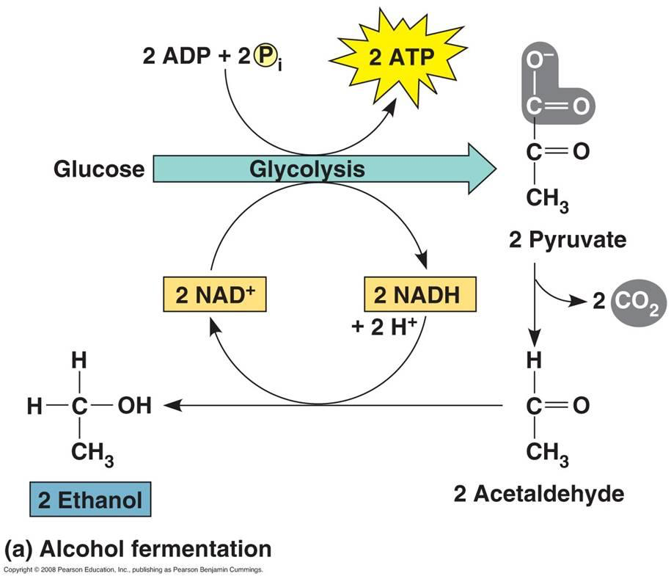
Vinegar Production
A two step process
I. Alcohol Fermentation (Saccharomyces spp.)

Slide 31
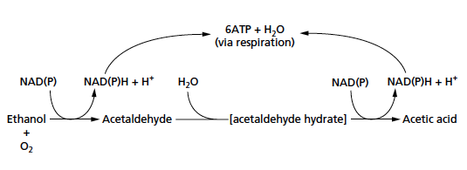
Vinegar Production
A two step process
II. Acetic acid fermentation (Acetobacter and Gluconobacters spp.)

Slide 32
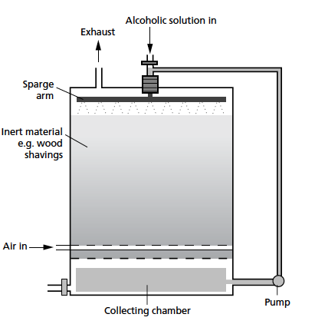
Methods of acidification in vinegar manufacture
Traditional surface methods
Trickling generators
Submerged methods

Slide 33
Fermented Vegetables
Sauerkraut & Pickling
Prepared from wilted shredded cabbage mixed with 2–3% (w/w) salt to reduce water activity and inhibit the growth of Gram-negative bacteria.
Prepared using lactic acid bacteria, especially Lactobacillus and Leuconostoc spp.
Sauerkraut fermentation lasts for 20–30 days at 18–20°C and final lactic acid levels reach 1.5% (v/v).

Slide 34
Fermented meats
Fermented sausages are produced as a result of by lactic fermentation of a mixture of comminuted meat mixed with fat, salt, curing agents (nitrate/nitrite), sugar and spices.
Lactic acid bacteria (Lactobacilli and Pediococci) and catalase-positive cocci (S. carnosus, Micrococcus varians).
Yeasts and molds that are available as starters include Debaryomyces hansenii , Candida famata and Penicillium nalgiovense and P. chrysogenum , respectively.

Slide 35
Soya bean fermentations
Fermented soya bean products are a major part of the diet in south-east Asia, where they are largely substitutes for fermented dairy products.
There are several different solid, paste and liquid products such as tempeh, miso and soy sauces, respectively.
Tempeh:
Fermentation of cooked whole or dehulled soya beans by Rhizopus species.

Slide 36
Soya bean fermentations
Soy sauces
Soy sauce manufacture involves three basic stages:
Koji:
Is a solid substrate aerobic fermentation of cooked soya beans along with wheat flour or rice.
Aspergillus oryzae is used to hydrolyze starch, protein and pectins.
Moromi
Anaerobic fermentation of the liquid slurry that results from the addition of brine (24% (w/v) sodium chloride solution)
Pediococcus halophilus initially acidify and prevent spoilage.
Candida species or Zygosaccharomyces rouxii perform an alcoholic fermentation and produce additional flavor compounds such as furanones.

Slide 37
Coffee fermentation
Berries of the coffee plant (Coffea arabica and Coffea canephora) are processed to obtain the bean from within by either a dry or wet process.
The wet process, which generally produces better quality beans, involves the activities of indigenous bacteria, filamentous fungi and yeasts.
The pulpy material that surrounds the beans is removed by the action of endogenous plant enzymes, pectinolytic bacteria and fungi.
This is followed by an acid fermentation by lactic acid bacteria, primarily Leuconostoc and Lactobacillus.

